Slide 1

EuPA initiative for Proteomics Bioinformatics
Meeting 23.10.15 - Agenda

Slide 2
Agenda
1- Introduction
2- Aims
3- Organization
4- Communication
5- ToDo
Aim: max 45 min

Slide 3
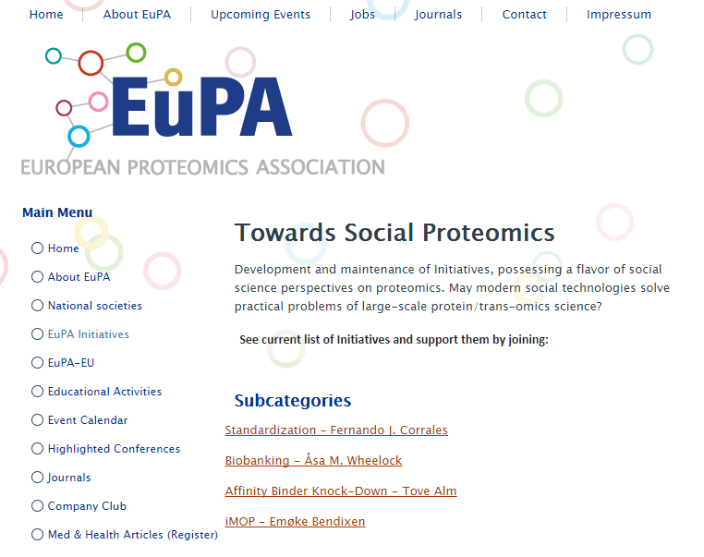
Introduction
Proteomics Bioinformatics – Us!
-> Open
-> Constructive
-> Collaborative

Slide 4
Aims
Support of user oriented bioinformatics.
1- New Funding Strategies
-> Crowd Sourcing/Funding
2- Better Valuation
-> New publications
3- Better Coordination
-> Proteomics Bioinformatics Conference
-> See proposal

Slide 5
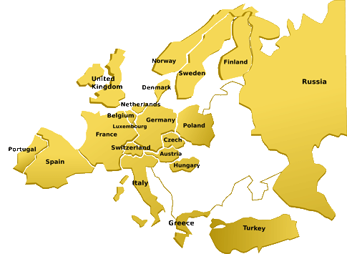
Organization
Community based.
-> Representatives of the member act as contact points
-> See Excel Document
-> Kick-off meeting in December

Slide 6
Communication
Give a positive image of proteomics bioinformatics.
1- National Networks
-> Talk around you
2- Online Networks
-> Twitter, LinkedIn, etc.
3- Website
-> Community, user oriented
Insert Name and Logo here

Slide 7
ToDo
Let’s get started...
1- Kick-off Meeting
2- Communication
3- Next Meeting

Slide 8
EuPA initiative for Proteomics Bioinfromatics
Danke schön! Dank u wel! Mange tak! Merci! Grazie! Takk! Спасибо! Muchas Gracias! Thank you!

